Slide 1
Torah Bible Study
Sunday mornings

Slide 2
Opening Prayer
Notes:
Speak to us, living God, as you have spoken to our ancestors
so that we can know you better,
And that we can know your thoughts and desires for us,
through Jesus Christ our Savior. Amen.

Slide 3
Documentary Hypothesis
SOURCE CONTEXT LOCATION DATE
J source United Monarchy Jerusalem 950 BCE
E source Divided Monarchy Northern Kingdom 850 BCE
D source Reign of Josiah Southern Kingdom 625 BCE
P source End of the Exile Babylon/Jerusalem 500 BCE

Slide 4
Brief Outline of Genesis
Primeval/Prehistory (Up to 1800 BCE) Chapters 1 – 11
Two Stories of Creation 1:1 – 3:24
The Primeval Period 4:1 – 6:4
The Great Flood 6:5 – 9:17
The Origin of the World’s Cultures 9:18 – 11:32
The Ancestral Period (1800 – 1500 BCE) Chapters 12 – 50
Abraham’s Family 12:1 – 25:18
Jacob’s Family 25:19 – 36:43
Joseph and His Family’s Move to Egypt 37:1 – 50:26
Notes:
First Creation Story: Genesis 1:1-2:4a
Second Creation Story: Genesis 2:4b-2:25
Story of Adam and Eve and the Serpent: Genesis 3:1-24
Genesis 4 Cain Murders Abel:
Genesis 5: From Adam to Noah
Genesis 6: Noah and the Ark
Genesis 7: The Great Flood
Genesis 8: The Flood Subsides
Genesis 9: The Covenant with Noah and Drunken Noah and Sons
Genesis 10: The Nations Descended from Noah’s Sons: Japheth, Ham, and Shem
Genesis 11: The Tower of Babel and Descendants to Terah and son Abram
Genesis 12: The Call of Abram

Slide 5
Genesis 1:1-2:3
The First Creation story

Slide 6
The Priestly Account of Creation
Genesis 1:1 – 2:4 is the Priestly account of creation written during the time of exile in Babylon or shortly after the return to Jerusalem.
Their story of creation is told over against the stories of creation told within Babylon.
KEY QUESTIONS:
Who is God? Who are we as humans?
The First Creation Story
Notes:
The ancient Israelites divided the world into Heaven, Earth, Sea, and the Underworld.
They viewed the sky as a vault resting on foundations—mountains—with doors and windows that let in the rain. God dwelt above the sky, hidden in cloud and majesty.
The world was viewed as a disk floating on the waters, secured or moored by pillars.
The underworld (Sheol) was a watery or dusty prison from which no one returned. Regarded as a physical place beneath the earth, it could be reached only through death.

Slide 7
Other Accounts of Creation
In the Enuma Elish from Babylon:
Marduk cuts grandmother in half to create heavens and the earth.
In this creation story from Genesis:
God wills it, speaks it and it happens.
God is the creator of the cosmos, creating order from chaos (days 1 to 3) and filling the emptiness (days 4 to 6).
From the Ancient Near East
Notes:
For a video on this story: https://youtu.be/R5btTPN-NmM
Another video summary: https://youtu.be/U74xXGRaBiM
The Enuma Elish (also known as The Seven Tablets of Creation) is the Mesopotamian creation myth whose title is derived from the opening lines of the piece, "When on High". The myth tells the story of the great god Marduk's victory over the forces of chaos and his establishment of order at the creation of the world.
The story, one of the oldest, if not the oldest in the world, concerns the birth of the gods and the creation of the universe and human beings. In the beginning, there was only undifferentiated water swirling in chaos. Out of this swirl, the waters divided into sweet, fresh water, known as the god Apsu, and salty bitter water, the goddess Tiamat. Once differentiated, the union of these two entities gave birth to the younger gods.
These young gods, however, were extremely loud, troubling the sleep of Apsu at night and distracting him from his work by day. Upon the advice of his Vizier, Mummu, Apsu decides to kill the younger gods. Tiamat, hearing of their plan, warns her eldest son, Enki (sometimes Ea) and he puts Apsu to sleep and kills him. From Apsu's remains, Enki creates his home.
Tiamat, once the supporter of the younger gods, now is enraged that they have killed her mate. She consults with the god, Quingu, who advises her to make war on the younger gods. Tiamat rewards Quingu with the Tablets of Destiny, which legitimize the rule of a god and control the fates, and he wears them proudly as a breastplate. With Quingu as her champion, Tiamat summons the forces of chaos and creates eleven horrible monsters to destroy her children.
Ea, Enki, and the younger gods fight against Tiamat futilely until, from among them, emerges the champion Marduk who swears he will defeat Tiamat. Marduk defeats Quingu and kills Tiamat by shooting her with an arrow which splits her in two; from her eyes flow the waters of the Tigris and Euphrates Rivers. Out of Tiamat's corpse, Marduk creates the heavens and the earth, he appoints gods to various duties and binds Tiamat's eleven creatures to his feet as trophies (to much adulation from the other gods) before setting their images in his new home. He also takes the Tablets of Destiny from Quingu, thus legitimizing his reign.
After the gods have finished praising him for his great victory and the art of his creation, Marduk consults with the god Ea (the god of wisdom) and decides to create human beings from the remains of whichever of the gods instigated Tiamat to war. Quingu is charged as guilty and killed and, from his blood, Ea creates Lullu, the first man, to be a helper to the gods in their eternal task of maintaining order and keeping chaos at bay.
As the poem phrases it, "Ea created mankind/On whom he imposed the service of the gods, and set the gods free" (Tablet VI.33-34). Following this, Marduk "arranged the organization of the netherworld" and distributed the gods to their appointed stations (Tablet VI.43-46). The poem ends in Tablet VII with long praise of Marduk for his accomplishments.

Slide 8
Other Accounts of Creation
In the Epic of Atrahasis from Babylon: Humans are created as an afterthought, as grunt workers for the gods.
In this creation story from Genesis:
All of humanity bears God’s image and likeness, called very good; and
All humans are given royal status; dominion over all creatures.
Human beings are created both in the image of God, the Creator, and to be the image of God in the life of the world.
From the Ancient Near East
Notes:
Cartoon Video summary of the story of Atrahasis: https://youtu.be/KqmQKHCe6p4

Slide 9
Genesis 1:1–2 (NRSV)
¹ In the beginning when God created the heavens and the earth, ² the earth was a formless void and darkness covered the face of the deep, while a wind from God swept over the face of the waters.

Slide 10
The Priestly Account of Creation
Tohubohu – “formless void” in Hebrew
Two words:
tohu – formless
bohu – empty
The earth is an empty and mysterious deep.
It’s not about where the earth came from, but how God tamed the chaos.
The First Creation Story
Notes:
The ancient Israelites divided the world into Heaven, Earth, Sea, and the Underworld.
They viewed the sky as a vault resting on foundations—mountains—with doors and windows that let in the rain. God dwelt above the sky, hidden in cloud and majesty.
The world was viewed as a disk floating on the waters, secured or moored by pillars.
The underworld (Sheol) was a watery or dusty prison from which no one returned. Regarded as a physical place beneath the earth, it could be reached only through death.

Slide 11
Genesis 1:1–2 (NRSV)

Slide 12
Genesis 1:1–2 (NRSV)

Slide 13
Genesis 1:3-5 (NRSV)
³ Then God said, “Let there be light”; and there was light. ⁴ And God saw that the light was good; and God separated the light from the darkness. ⁵ God called the light Day, and the darkness he called Night. And there was evening and there was morning, the first day.

Slide 14
Genesis 1:6 (NRSV)
⁶ And God said, “Let there be a dome in the midst of the waters, and let it separate the waters from the waters.”

Slide 15
Genesis 1:7-8 (NRSV)
⁷ So God made the dome and separated the waters that were under the dome from the waters that were above the dome. And it was so. ⁸ God called the dome Sky. And there was evening and there was morning, the second day.

Slide 16
Genesis 1:9-10 (NRSV)
⁹ And God said, “Let the waters under the sky be gathered together into one place, and let the dry land appear.” And it was so. ¹⁰ God called the dry land Earth, and the waters that were gathered together he called Seas. And God saw that it was good.

Slide 17
Genesis 1:11 (NRSV)
¹¹ Then God said, “Let the earth put forth vegetation: plants yielding seed, and fruit trees of every kind on earth that bear fruit with the seed in it.” And it was so.

Slide 18
Genesis 1:12-13 (NRSV)
¹² The earth brought forth vegetation: plants yielding seed of every kind, and trees of every kind bearing fruit with the seed in it. And God saw that it was good. ¹³ And there was evening and there was morning, the third day.

Slide 19
Genesis 1:14-15 (NRSV)
¹⁴ And God said, “Let there be lights in the dome of the sky to separate the day from the night; and let them be for signs and for seasons and for days and years, ¹⁵ and let them be lights in the dome of the sky to give light upon the earth.” And it was so.

Slide 20
Genesis 1:16-19 (NRSV)
¹⁶ God made the two great lights—the greater light to rule the day and the lesser light to rule the night—and the stars. ¹⁷ God set them in the dome of the sky to give light upon the earth, ¹⁸ to rule over the day and over the night, and to separate the light from the darkness. And God saw that it was good. ¹⁹ And there was evening and there was morning, the fourth day.

Slide 21
Genesis 1:20-21 (NRSV)
²⁰ And God said, “Let the waters bring forth swarms of living creatures, and let birds fly above the earth across the dome of the sky.” ²¹ So God created the great sea monsters and every living creature that moves, of every kind, with which the waters swarm, and every winged bird of every kind. And God saw that it was good.

Slide 22
Genesis 1:22-23 (NRSV)
²² God blessed them, saying, “Be fruitful and multiply and fill the waters in the seas, and let birds multiply on the earth.” ²³ And there was evening and there was morning, the fifth day.

Slide 23
Genesis 1:24-25 (NRSV)
²⁴ And God said, “Let the earth bring forth living creatures of every kind: cattle and creeping things and wild animals of the earth of every kind.” And it was so. ²⁵ God made the wild animals of the earth of every kind, and the cattle of every kind, and everything that creeps upon the ground of every kind. And God saw that it was good.

Slide 24
Genesis 1:26 (NRSV)
²⁶ Then God said, “Let us make humankind in our image, according to our likeness; and let them have dominion over the fish of the sea, and over the birds of the air, and over the cattle, and over all the wild animals of the earth, and over every creeping thing that creeps upon the earth.”
Notes:
Let us make “adam” in our image…

Slide 25
Bible Project Video
Notes:
Let us make “adam” in our image…
Time: 5:12

Slide 27
Bible Project Video – Image of God
Notes:
“Humankind” – Adam
Time: 5:17

Slide 28
Genesis 1:27 (NRSV)
²⁷ So God created humankind in his image, in the image of God he created them; male and female he created them.
Notes:
“Humankind” – Adam
A poetic verse.
The first “them” is third person singular
The second “them” is third person plural.

Slide 29
Genesis 1:28 (NRSV)
²⁸ God blessed them, and God said to them, “Be fruitful and multiply, and fill the earth and subdue it; and have dominion over the fish of the sea and over the birds of the air and over every living thing that moves upon the earth.”

Slide 30
Genesis 1:28 (NRSV)
²⁸ God blessed them, and God said to them, “Be fruitful and multiply, and fill the earth and subdue it; and have dominion over the fish of the sea and over the birds of the air and over every living thing that moves upon the earth.”

Slide 31
Genesis 1:29 (NRSV)
²⁹ God said, “See, I have given you every plant yielding seed that is upon the face of all the earth, and every tree with seed in its fruit; you shall have them for food.

Slide 32
Genesis 1:30 (NRSV)
³⁰ And to every beast of the earth, and to every bird of the air, and to everything that creeps on the earth, everything that has the breath of life, I have given every green plant for food.” And it was so.

Slide 33
Genesis 1:31 (NRSV)
³¹ God saw everything that he had made, and indeed, it was very good. And there was evening and there was morning, the sixth day.

Slide 34
Genesis 2:1 (NRSV)
¹ Thus the heavens and the earth were finished, and all their multitude.

Slide 35
Genesis 2:2-3 (NRSV)
² And on the seventh day God finished the work that he had done, and he rested on the seventh day from all the work that he had done. ³ So God blessed the seventh day and hallowed it, because on it God rested from all the work that he had done in creation.

Slide 36
Genesis 2:4 (NRSV)
⁴ These are the generations of the heavens and the earth when they were created. In the day that the Lord God made the earth and the heavens,

Slide 37
Genesis 2:4 (NRSV)
⁴ These are the generations of the heavens and the earth when they were created. In the day that the Lord God made the earth and the heavens,
Notes:
Toledot – Translated as “generations” of the heavens and the earth.
An important word for the book of Genesis… we will see it again and again.

Slide 38
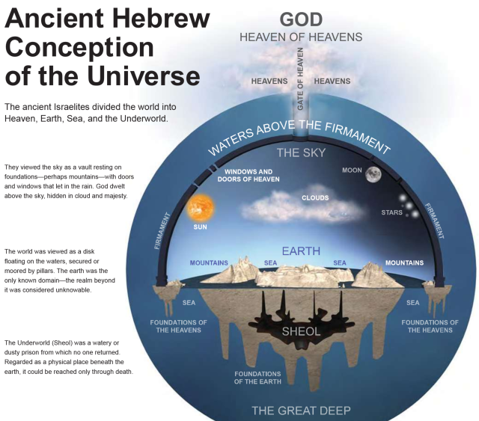
The Ancient View of the world
Notes:
Think snow globe inside a snow globe. That is the cosmology described there.
Water above and below, separated by sky. But it’s not creation ex nihilo (out of nothing).
It’s not about how the earth came into existence, but rather how the abyss, the deep, the chaos was put in order.
MONOPOLY
We can think of it like having a messy table covered with items and we want to play a game of Monopoly on that table. In order to play, we first need to clean off the table and make order from the chaos. Once that has happened, we can then fill the table with the pieces for the game. That’s essentially what God does in Genesis 1, creates order out of chaos, creates livable space and then fills it and calls it good. Human beings created and given dominion; created in the image of God.
The ancient Israelites divided the world into Heaven, Earth, Sea, and the Underworld.
They viewed the sky as a vault resting on foundations—mountains—with doors and windows that let in the rain. God dwelt above the sky, hidden in cloud and majesty.
The world was viewed as a disk floating on the waters, secured or moored by pillars.
The underworld (Sheol) was a watery or dusty prison from which no one returned. Regarded as a physical place beneath the earth, it could be reached only through death.

Slide 39
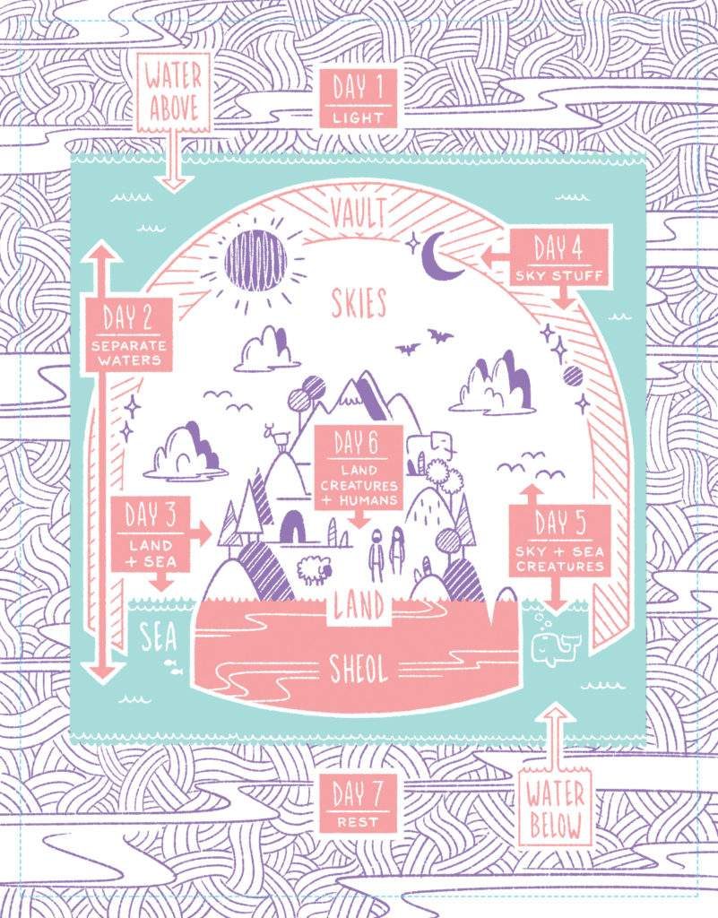
The Ancient View of the world
Notes:
The ancient Israelites divided the world into Heaven, Earth, Sea, and the Underworld.
They viewed the sky as a vault resting on foundations—mountains—with doors and windows that let in the rain. God dwelt above the sky, hidden in cloud and majesty.
The world was viewed as a disk floating on the waters, secured or moored by pillars.
The underworld (Sheol) was a watery or dusty prison from which no one returned. Regarded as a physical place beneath the earth, it could be reached only through death.

Slide 40
Bible Project Video Genesis 1
Notes:
Genesis 1
Time: 7:31

Slide 41
The Structure of Genesis 1:1-2:3

